Slide 1
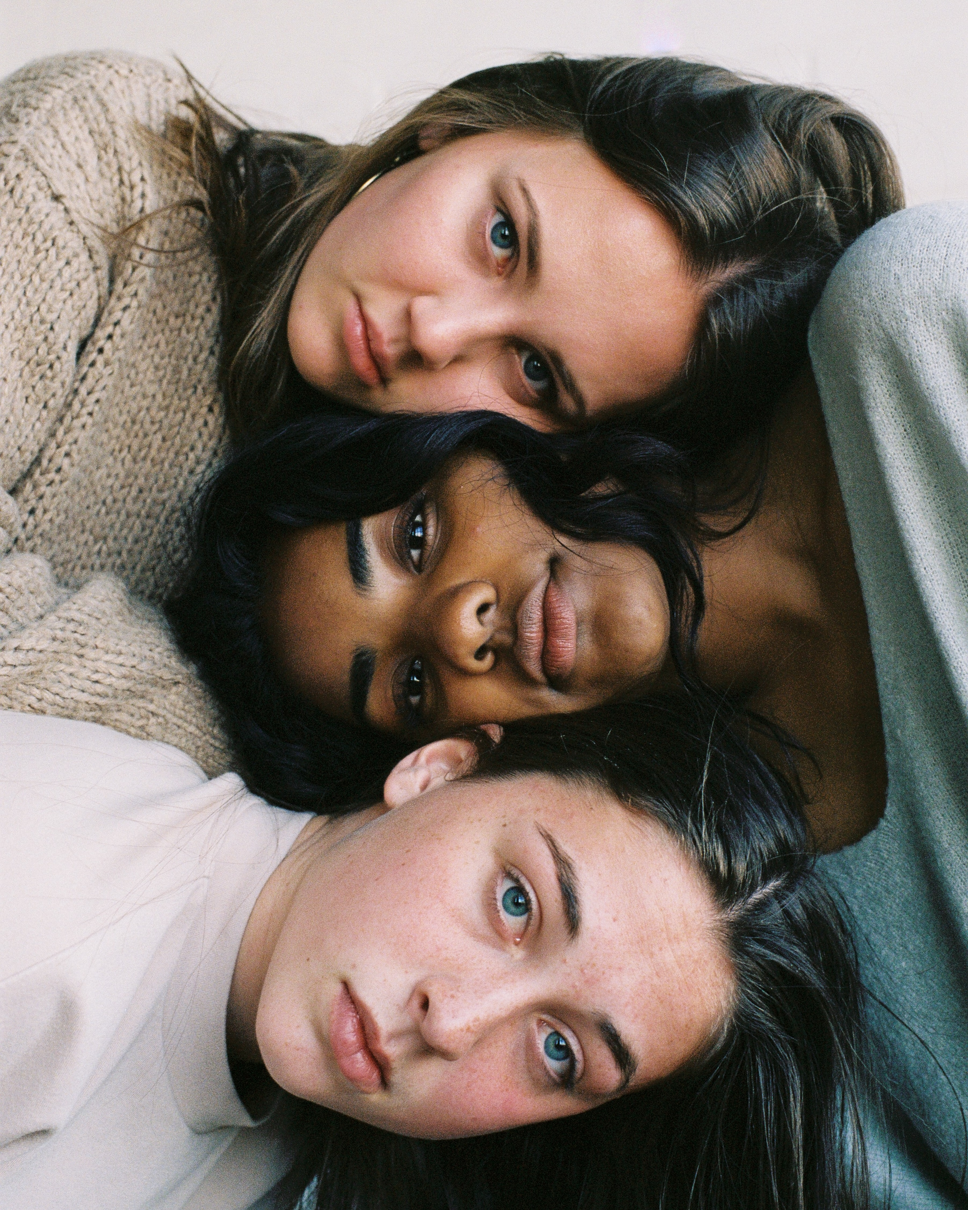
Migrant Women Empowerment
Migrant Women Empowerment
Workshop
Workshop
Project: 2021-2-PL01-KA210-ADU-000050955
www.women-power.eu

Slide 2
About the project
Migrant Women Empowerment
Workshop
The project Migrant Women Empowerment aims to promote inclusion, gender equality, non-discrimination, women's rights, and other important values among migrant women, women refugees, and other relevant stakeholders.
The project is a collaboration between ArtSmart (Latvia), MOVE to Be You (Austria) and Fundacja One World One Heart (Poland).
During the project's period, three different workshops will be held in Latvia, Poland, and Austria to achieve the project's objectives.
Project: 2021-2-PL01-KA210-ADU-000050955

Slide 3
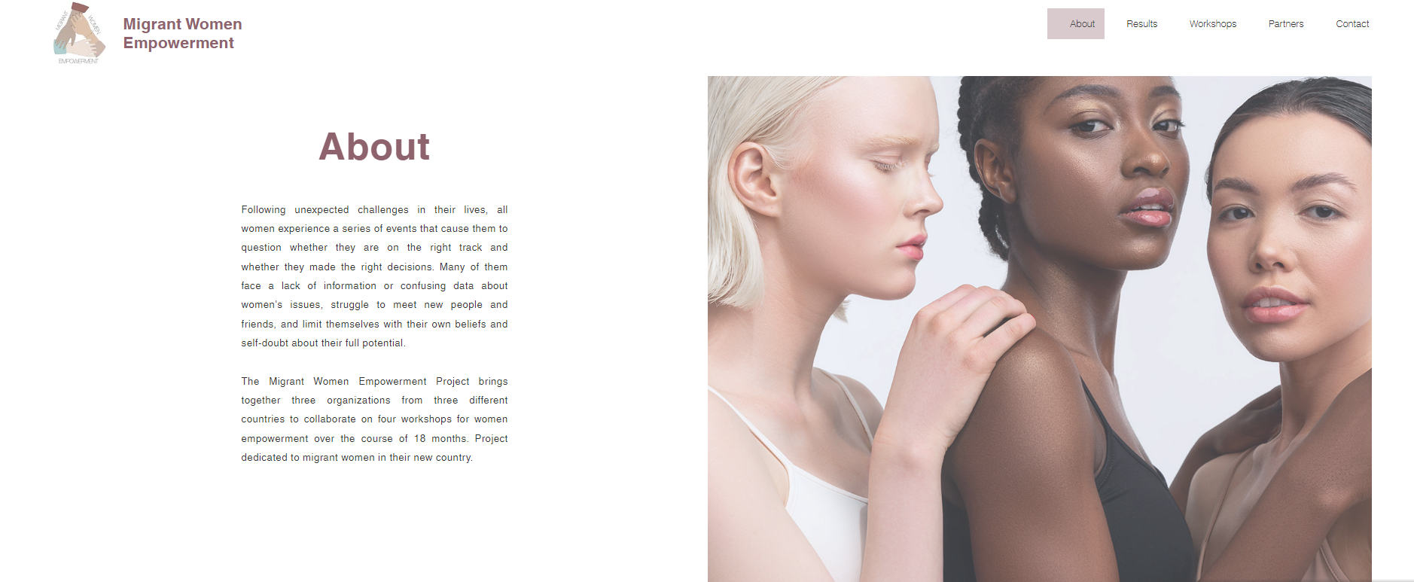
Read more
Migrant Women Empowerment
Workshop
Webpage: www.women-power.eu
Facebook: Migrant-Women-Empowerment Page
Instagram: @migrantwomenempowerment

Slide 4
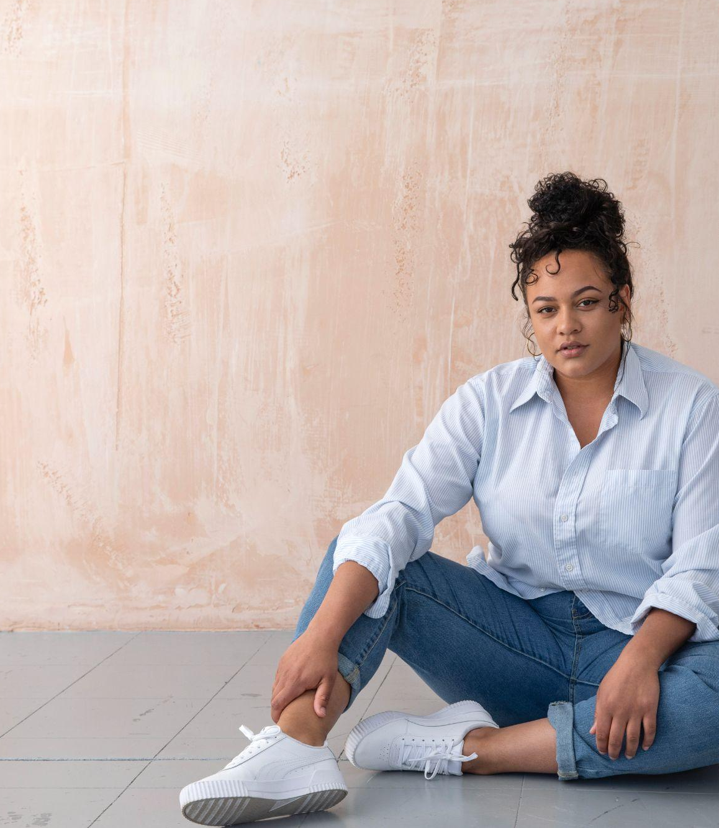
Migrant Women Empowerment
Workshop
Icebreaker
Bingo

Slide 5
5 minute break

Slide 6
Migrant Women Empowerment
Workshop
Picture a leader in your head.
Do you see a woman or a man?

Slide 7
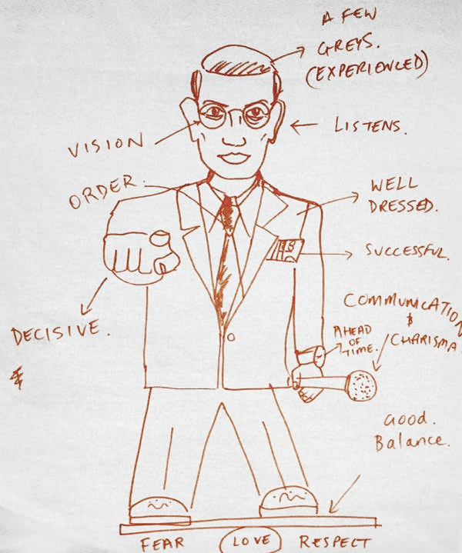
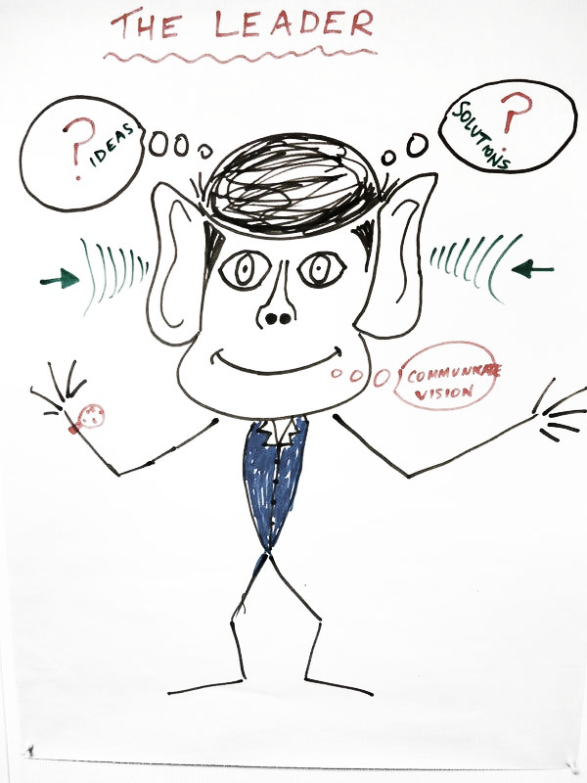
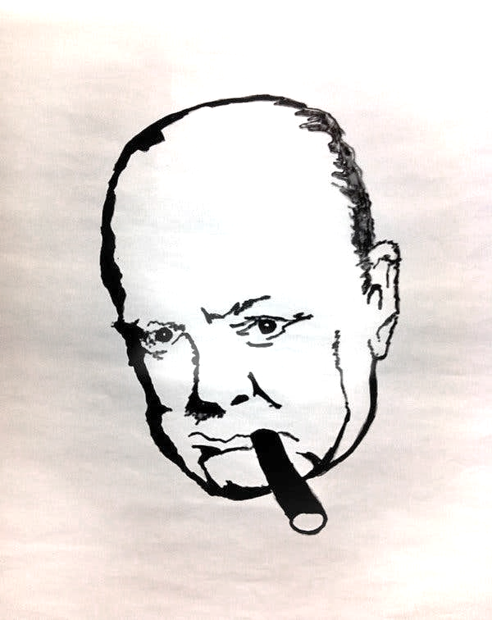
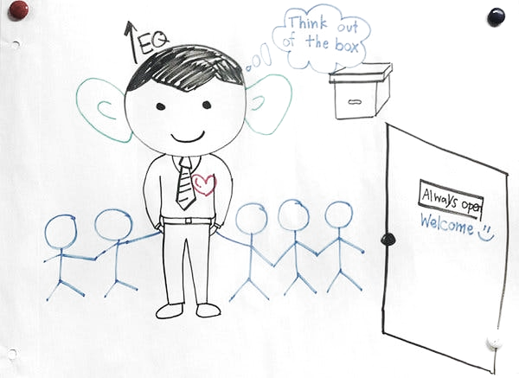
Picture a leader in your head. Do you see a woman or a man?
Migrant Women Empowerment
Workshop

Slide 8
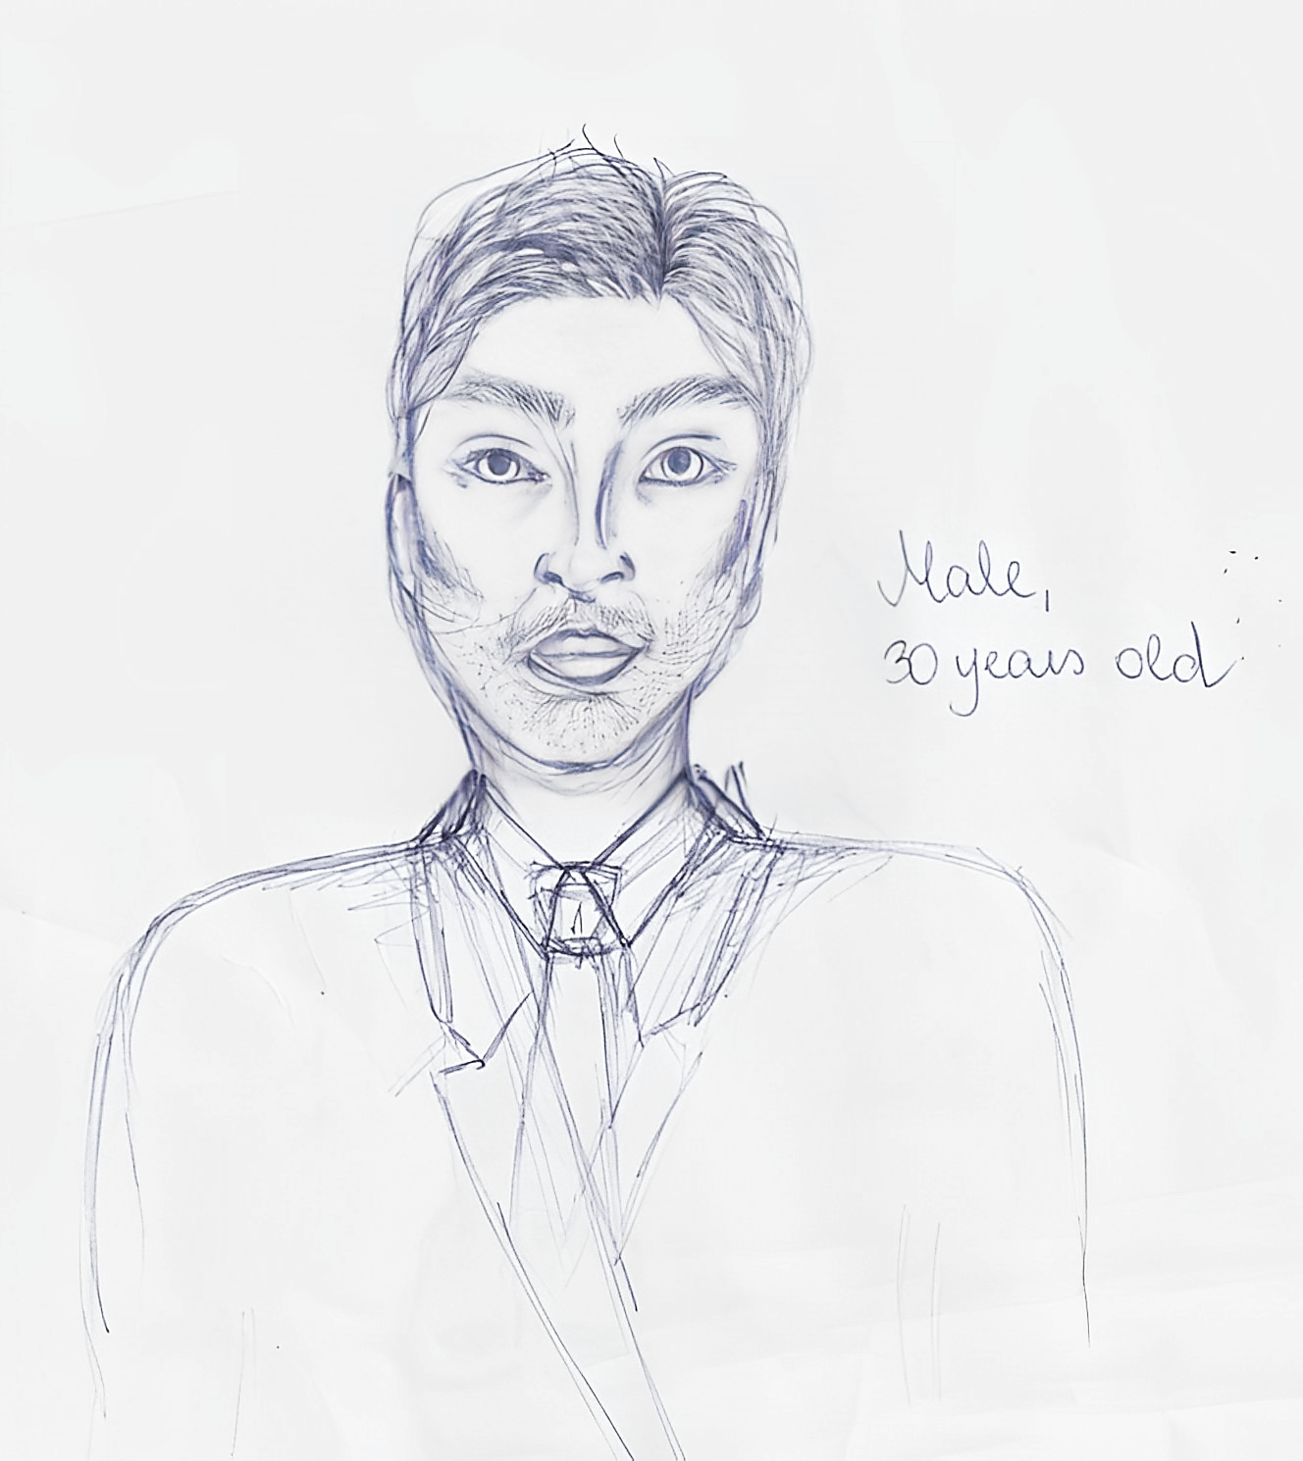
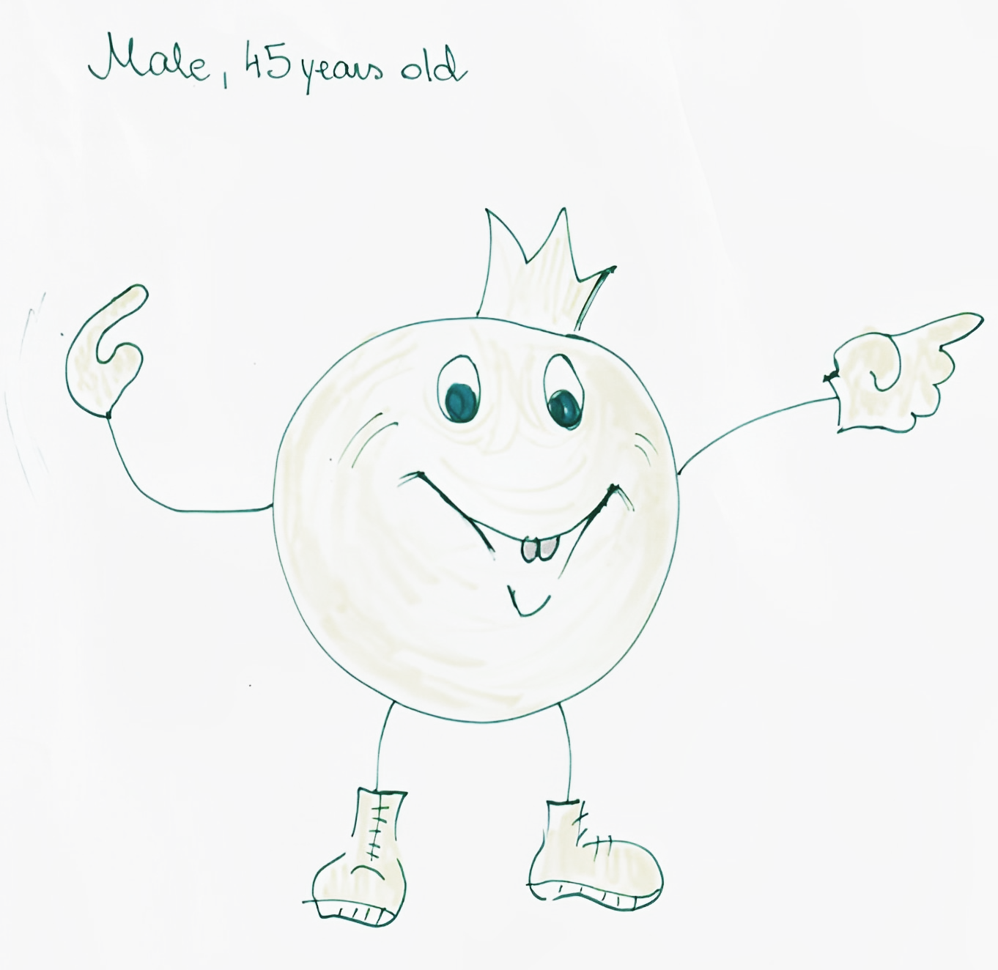
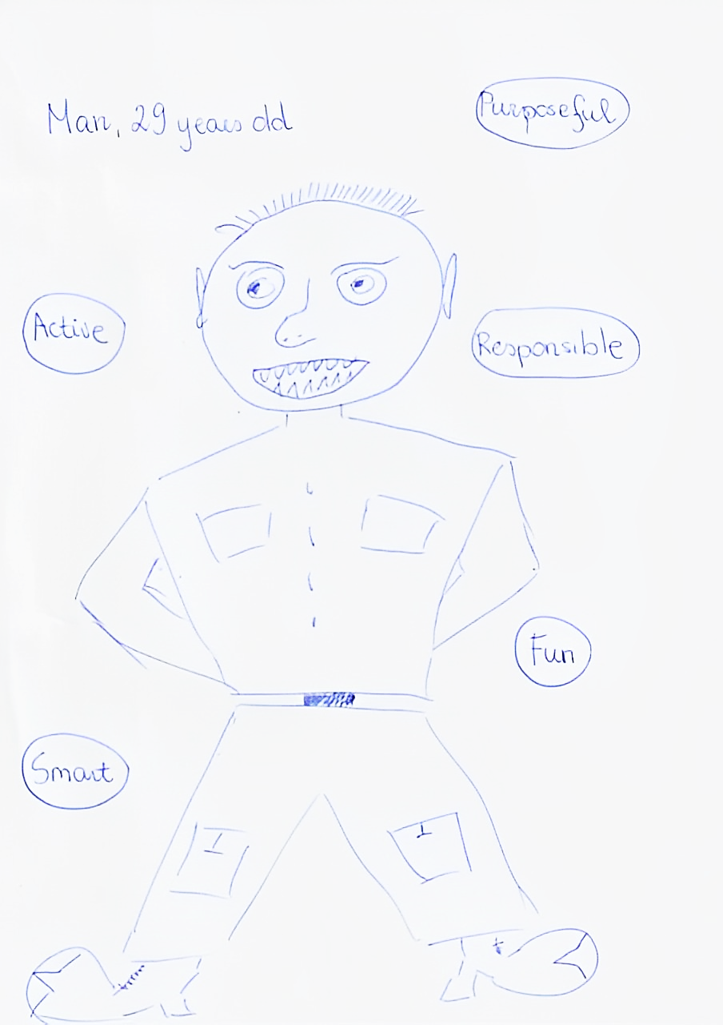
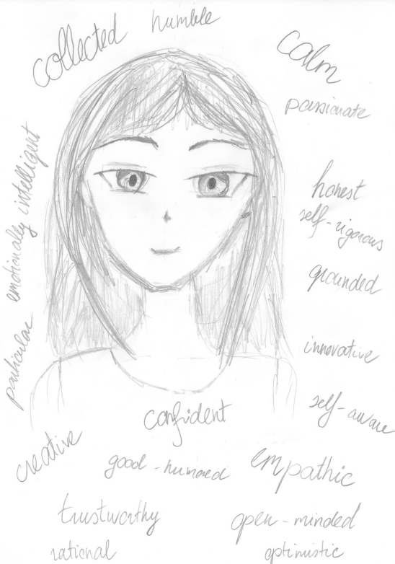
When you picture a leader, what do you see?
Migrant Women Empowerment
Workshop
I asked my family members and my best friend to draw a leader...

Slide 9
Women Are Underrepresented as Managers in the EU
Women are almost half of all those employed in the EU (46.3%) and yet were just 35.3% of managers as of 2021.
Percentage of Women Managers in Selected European Countries, 2021
Country | Percentage of Women Managers
European Union (27) | 35.3%
France | 38.3%
Germany | 30.1%
Italy | 28.6%
Netherlands | 25.5%
Norway | 35.2%
Spain | 33.9%
Sweden | 43.8%
Switzerland | 33.1%
Among the largest publicly listed companies in the European Union (EU-27) in 2021, only 20.2% of executives and 7.8% of CEOs are women

Slide 10
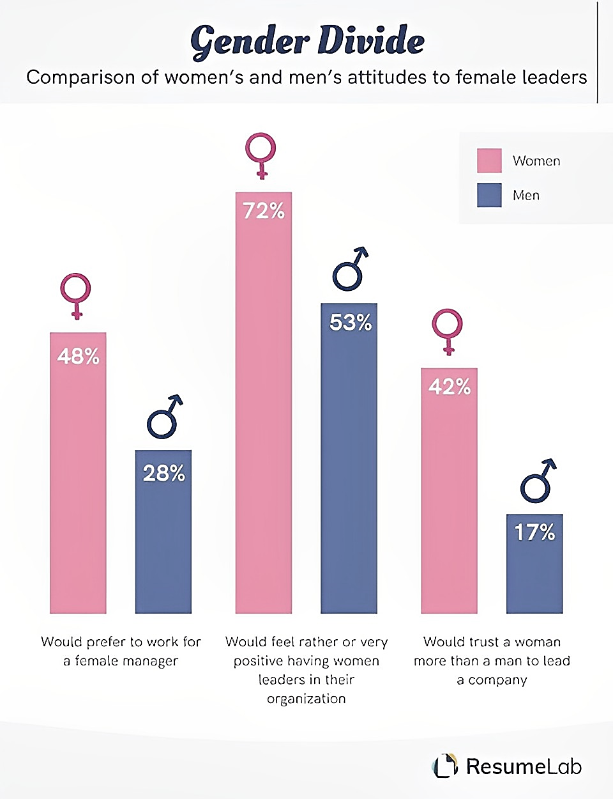
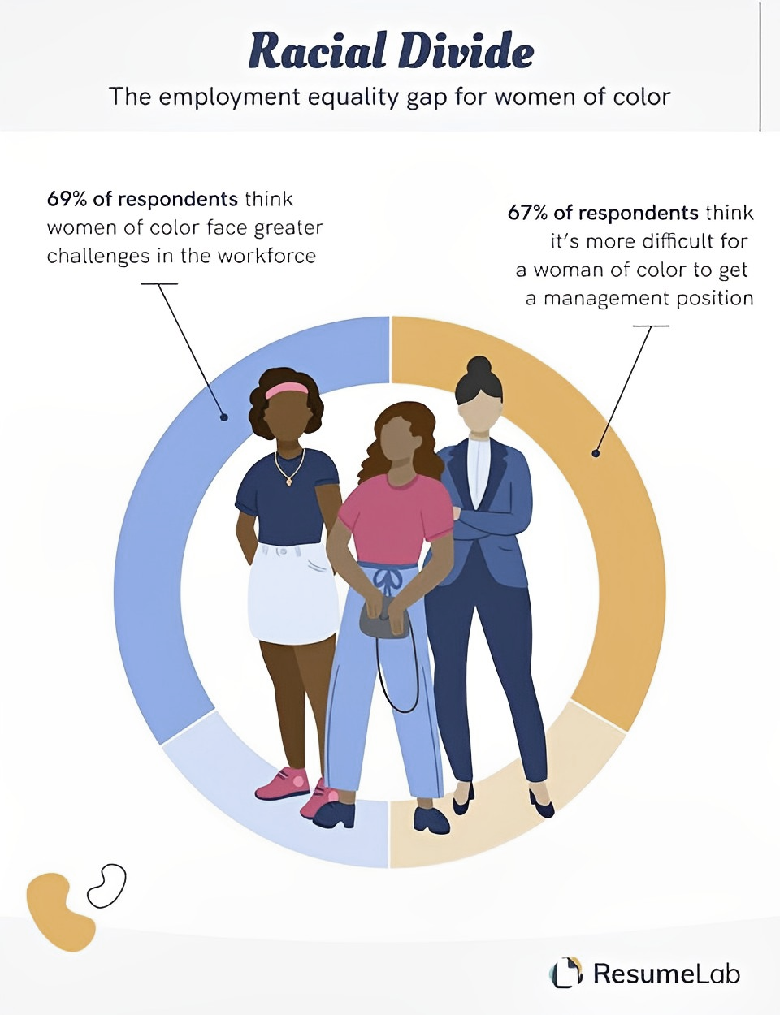

Slide 11
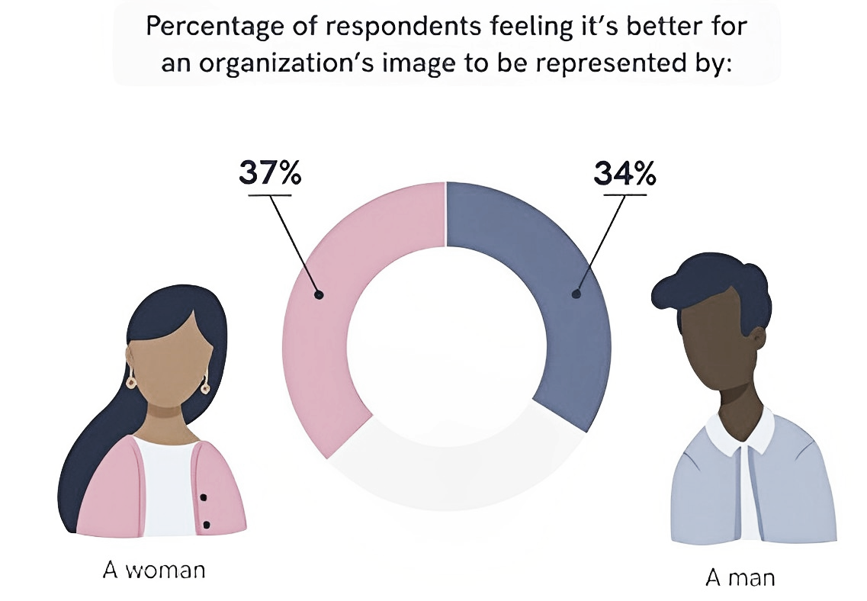
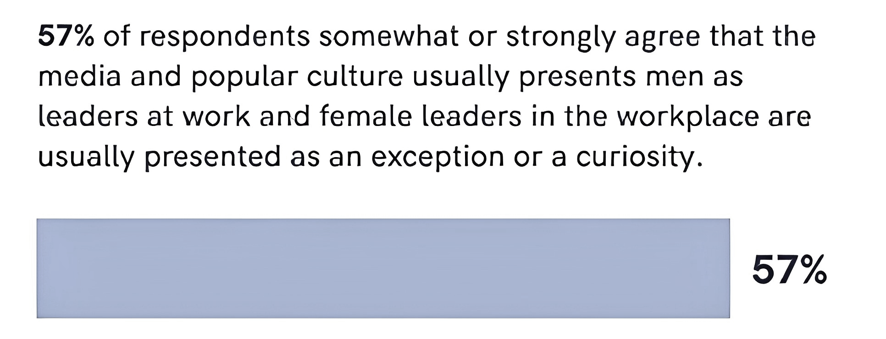
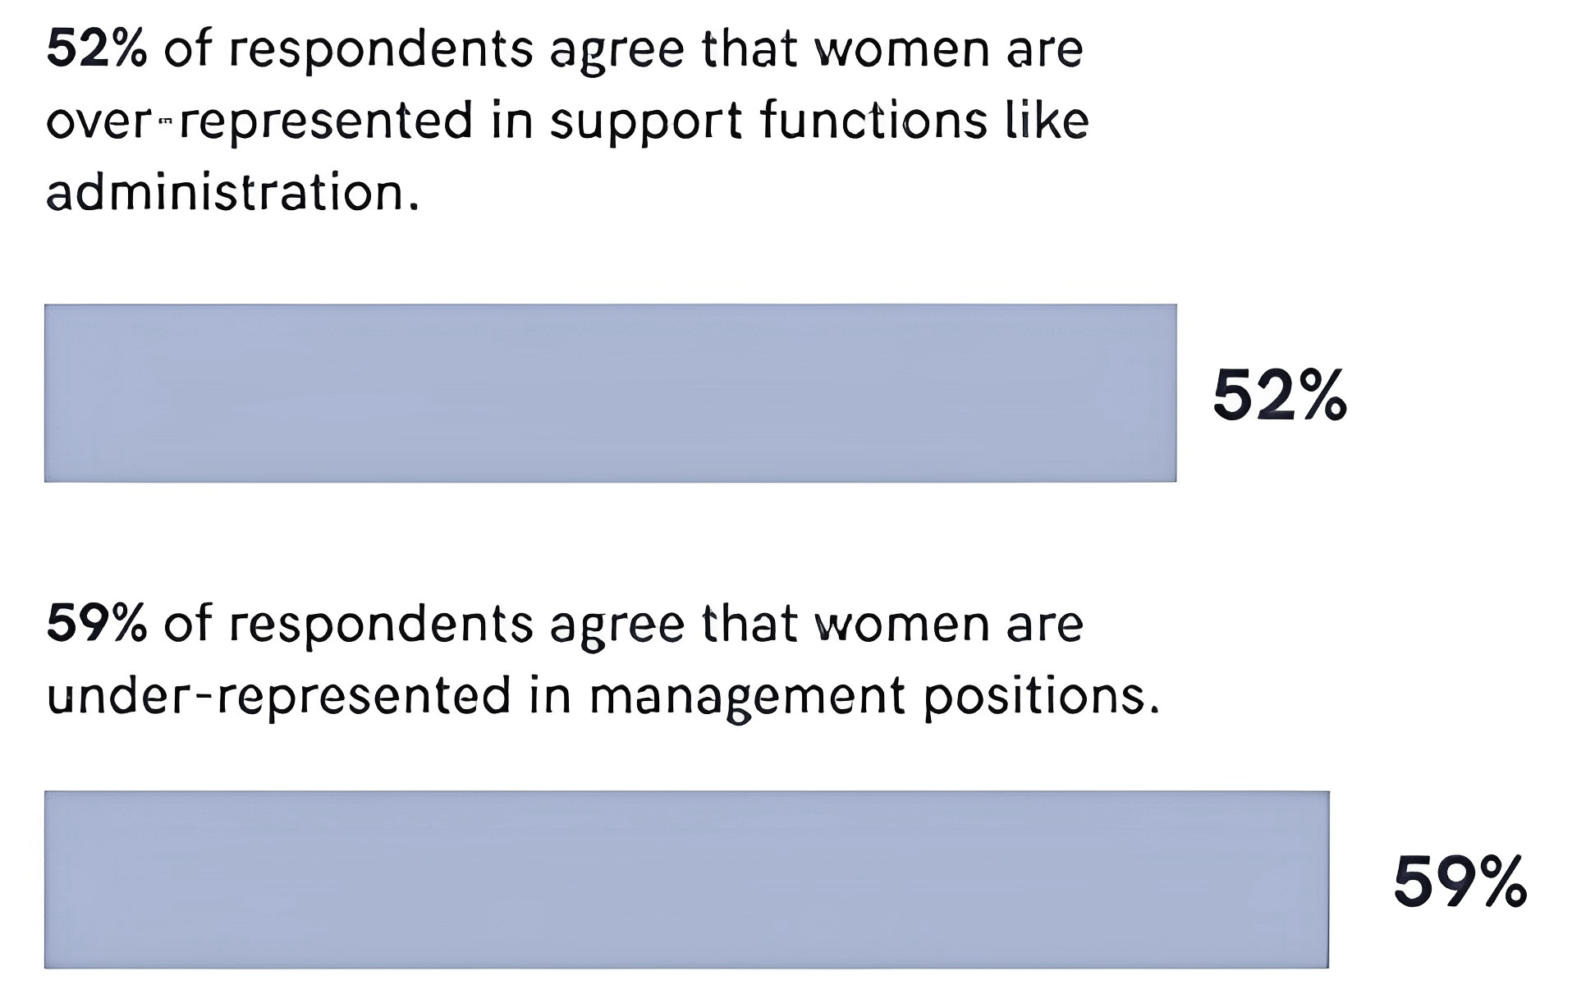
Migrant Women Empowerment
Workshop
*According to Forbes,com, 2021

Slide 12
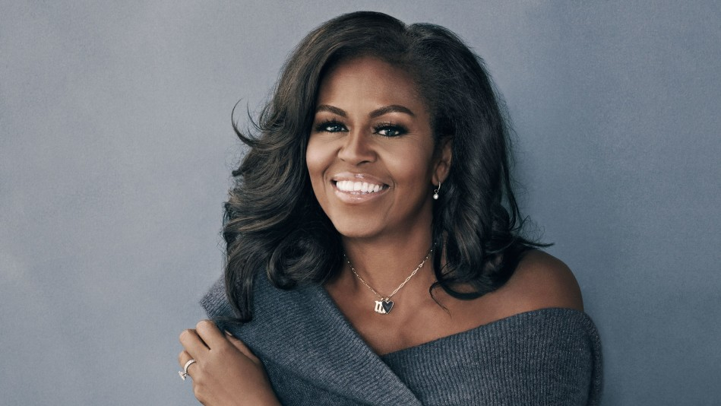
Ways Women Can Become More Effective
LEADERS
Don’t be afraid.
Be focused.
Be determined.
Be hopeful.
Be empowered.
Courage
Character
Confidence
Creativity
Communication
Commitment
Caring
Competence
Michelle Obama

Slide 13
5 minute break

Slide 14
I asked some of my friends to tell me, "Which women inspire you? And why?”

Slide 15
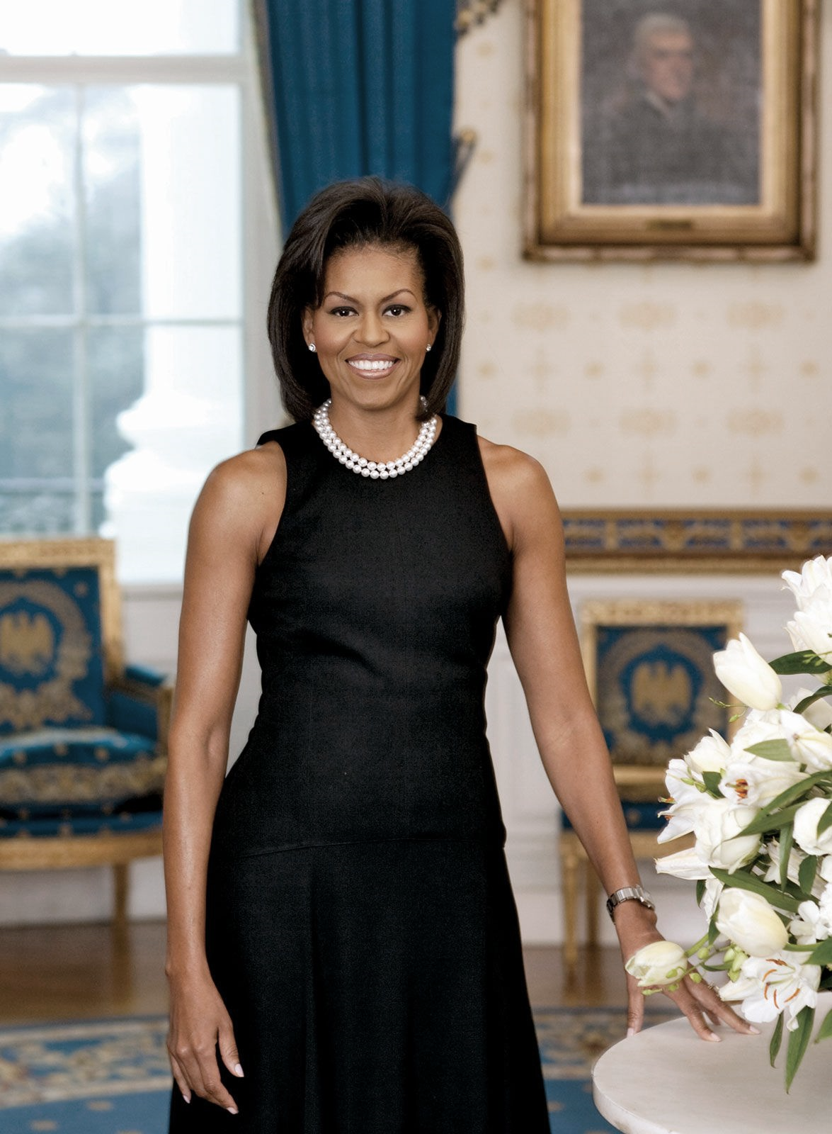
Inspiring women
Inspiring others to success...
Michelle Obama
She is best known as the former US First Lady, but long before becoming the wife of America’s first African American president, this strong and inspirational woman was changing the world.
“There is no limit to what we, as women, can accomplish.“- Michelle Obama
Notes:
https://www.headspacegroup.co.uk/inspiring-others-to-success-michelle-obama/

Slide 16
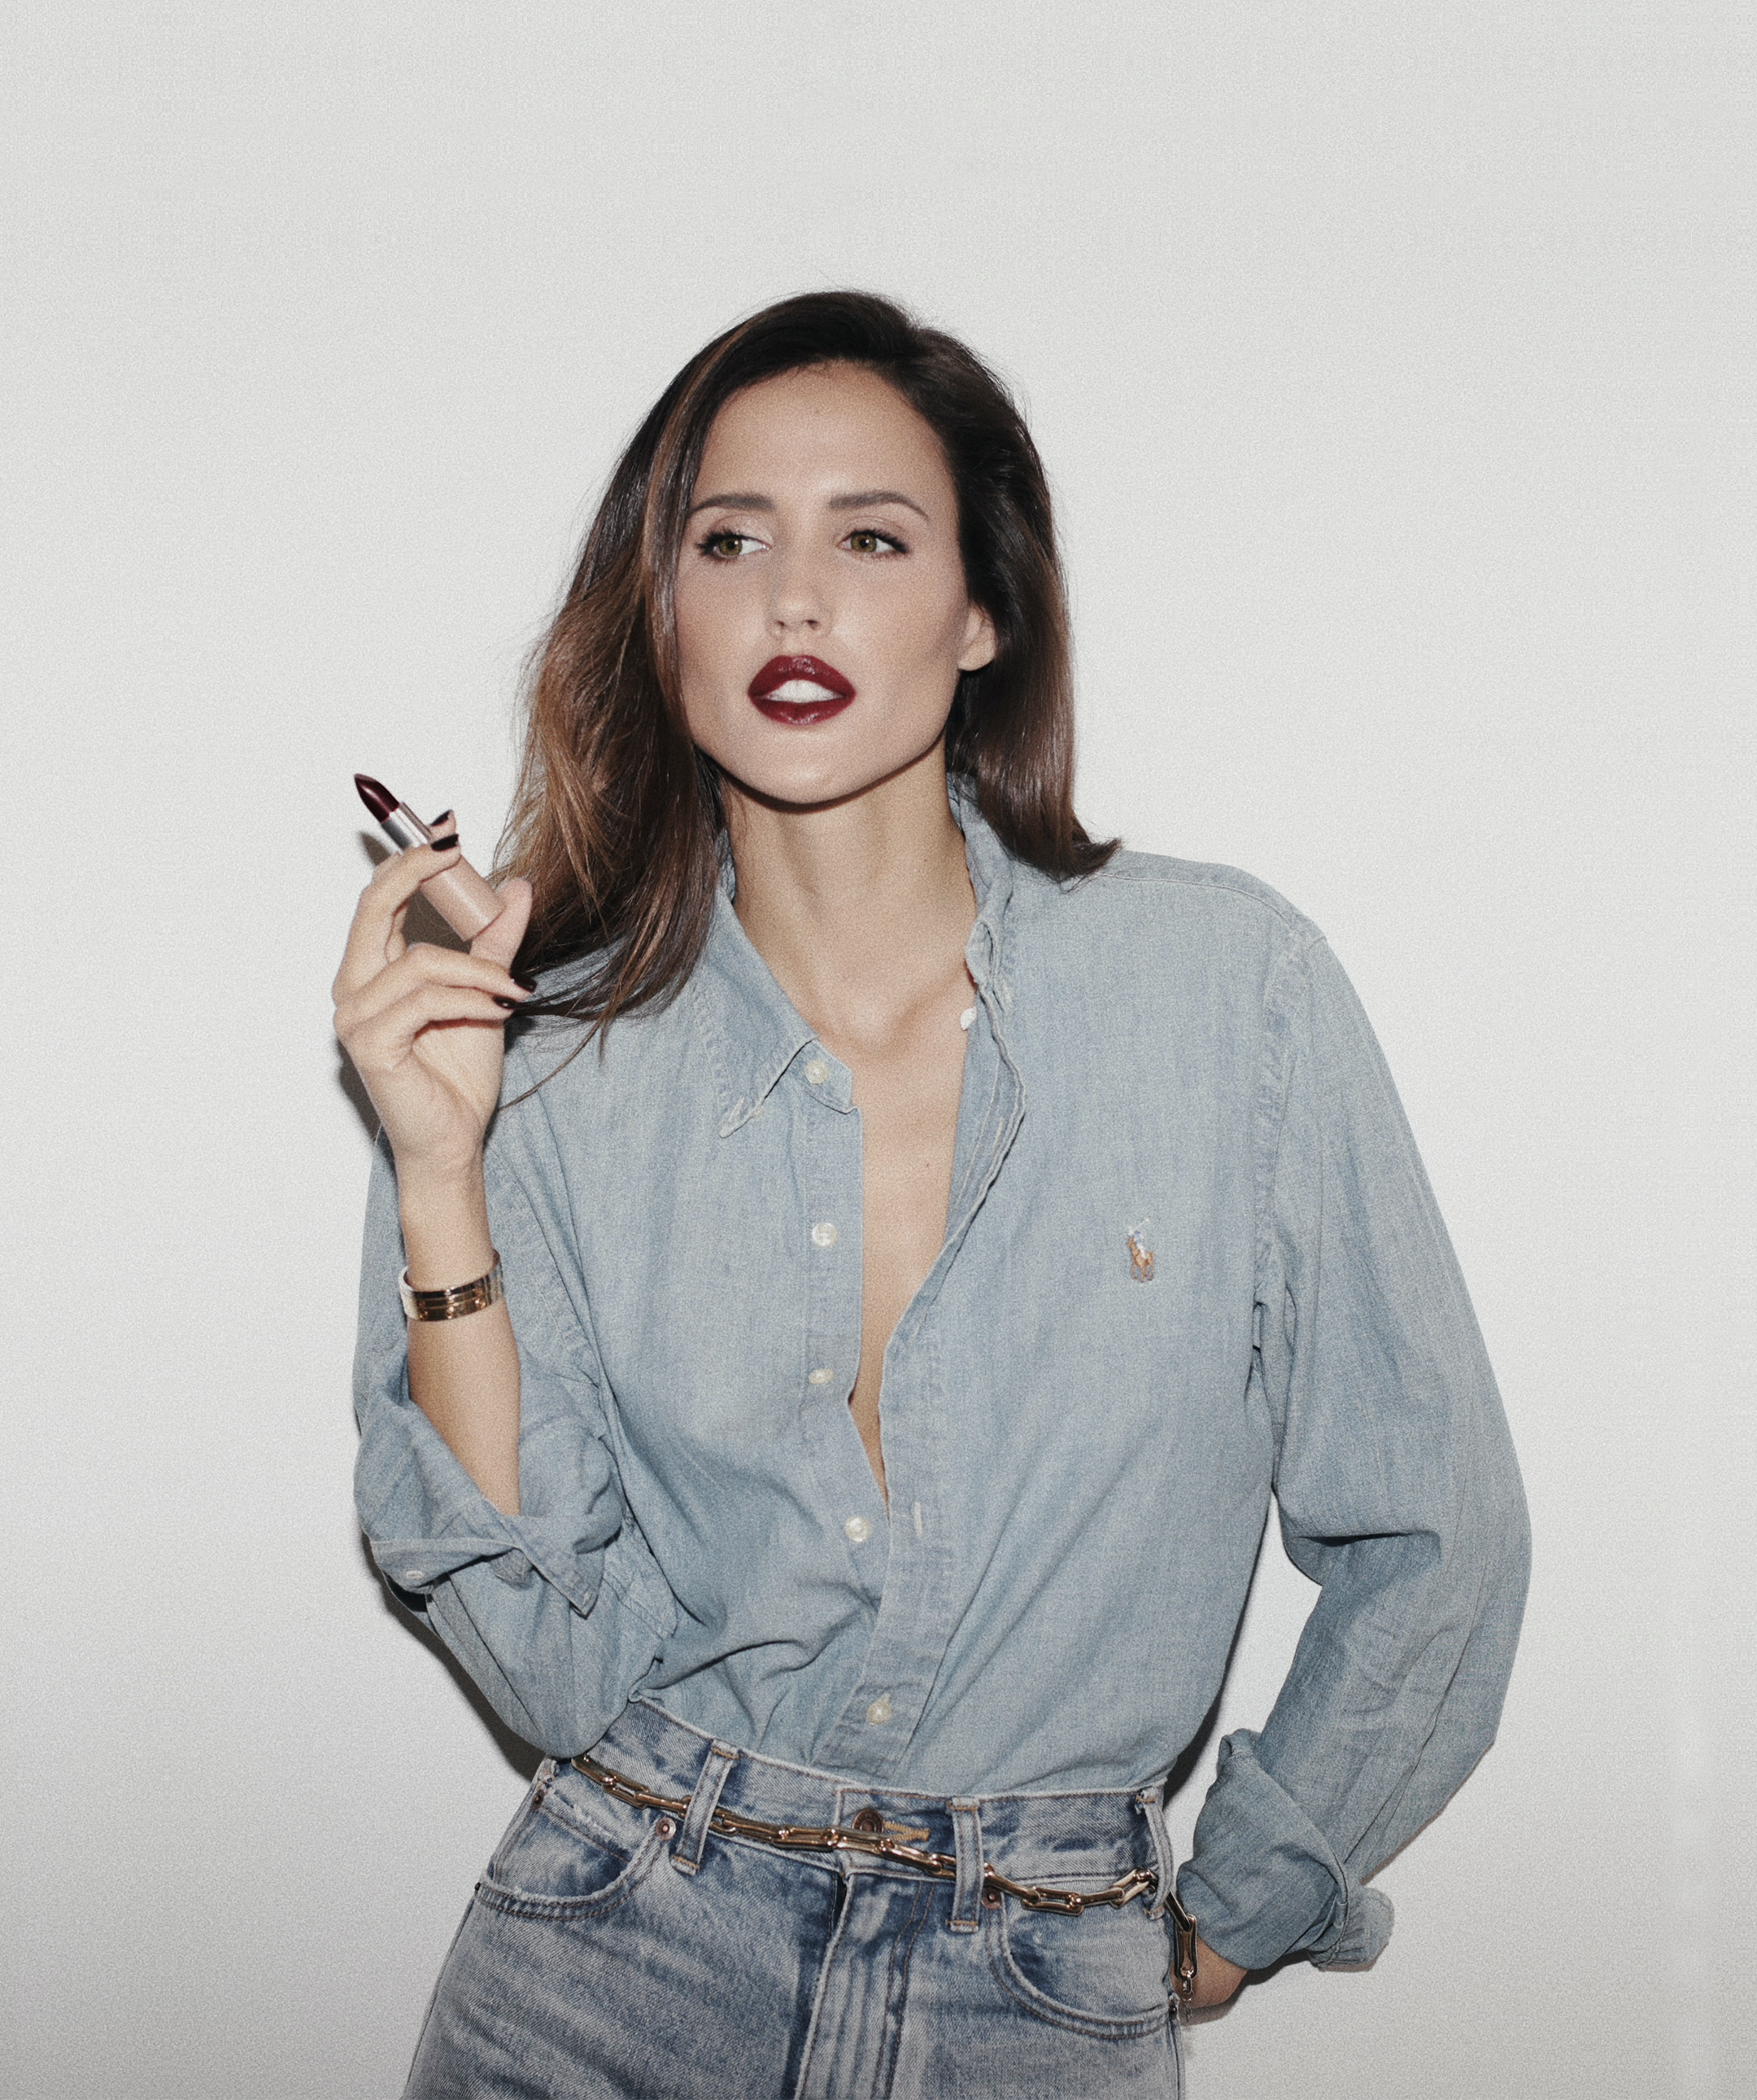
Inspiring women
Inspiring others to success...
Alex Rivière
Alex Rivière is a talented young entrepreneur from Barcelona who has become a style icon and one of the most influential people in the fashion system. She is a digital influencer, fashion consultant, and designer.
“ I refuse to make anything without meaning.”- Alex Rivière
Notes:
https://www.aquazzura.com/de_en/aquazzura-world/stories-en/stories-en/interview-alex-riviere

Slide 17
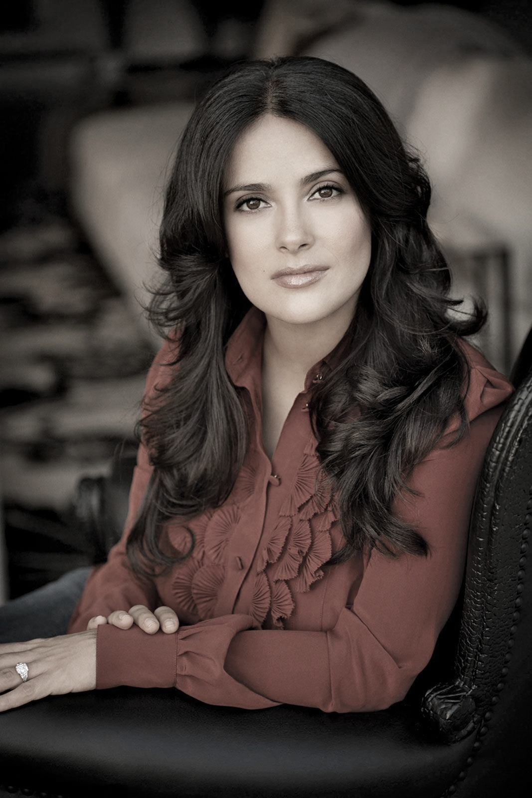
Inspiring women
Inspiring others to success...
Salma Hayek
In the 1990s Mexican American actress, director, and producer Salma Hayek broke barriers as one of the first Latinas to establish a successful movie career in the United States.
“I'll tell you, there is nothing better in life than being a late bloomer. I believe that success can happen at any time and at any age..“- Salma Hayek
Notes:
https://www.headspacegroup.co.uk/inspiring-others-to-success-michelle-obama/

Slide 18
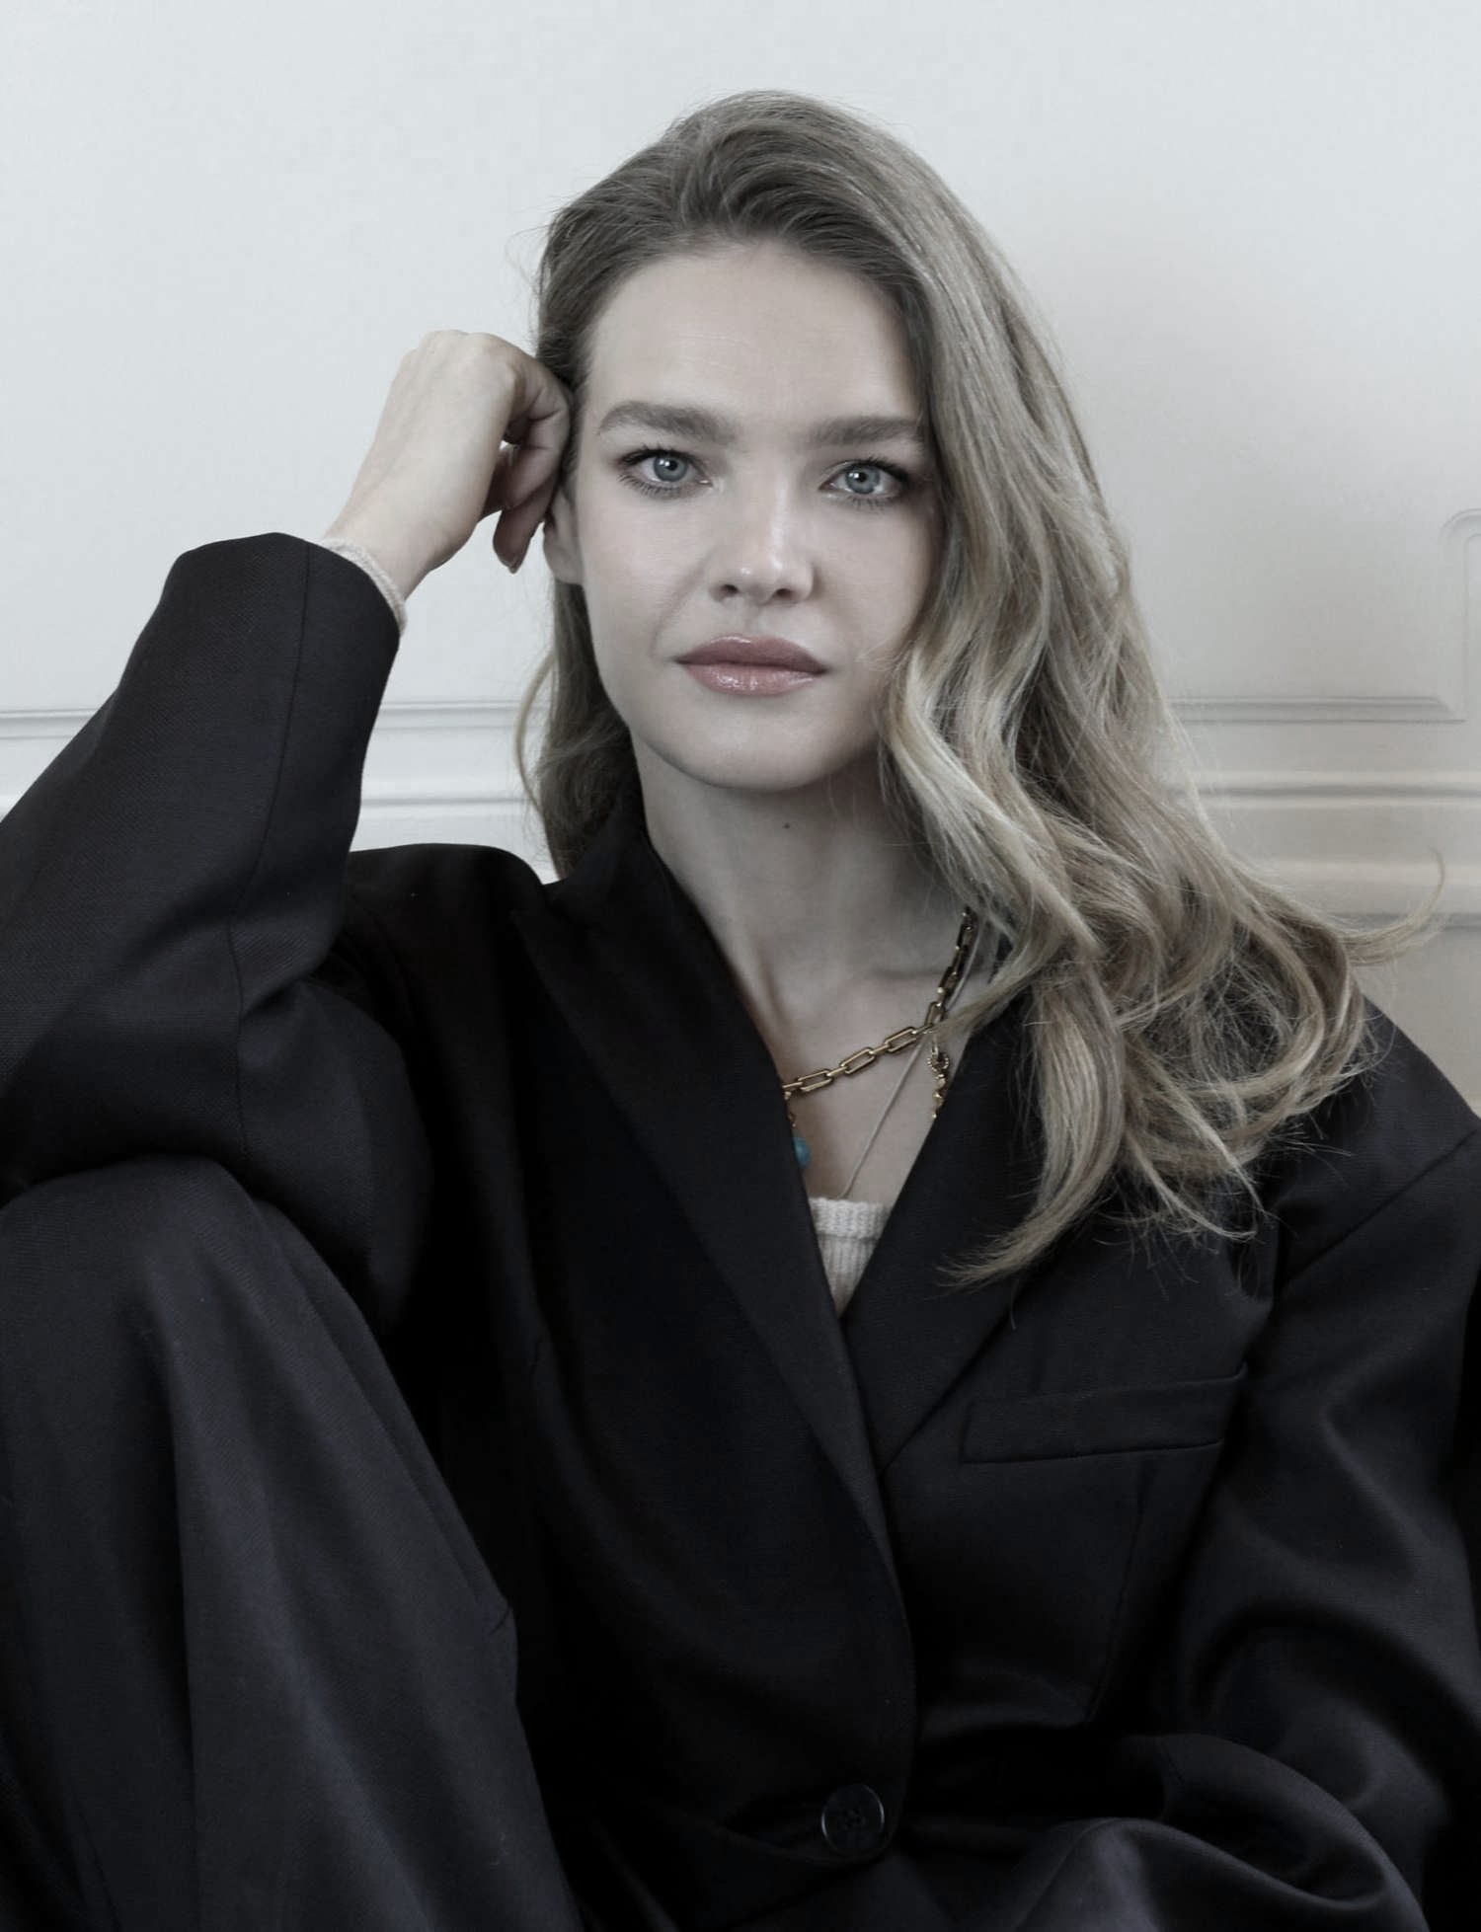
Inspiring women
Inspiring others to success...
Natalia Vodianova
She had to sell bananas on the street when she was young in order to make any money for her family. Today, she is a well-known model, actress, and UN Goodwill Ambassador. Vodianova is a founder of the Naked Heart Foundation and supports numerous other philanthropic causes.
“When you are at the bottom, you find beauty in such little things, and goodness in such little gestures. When I compare any struggle today to ones that I may have had in my childhood, there is nothing that can bring me down.” - Natalia Vodianova

Slide 19
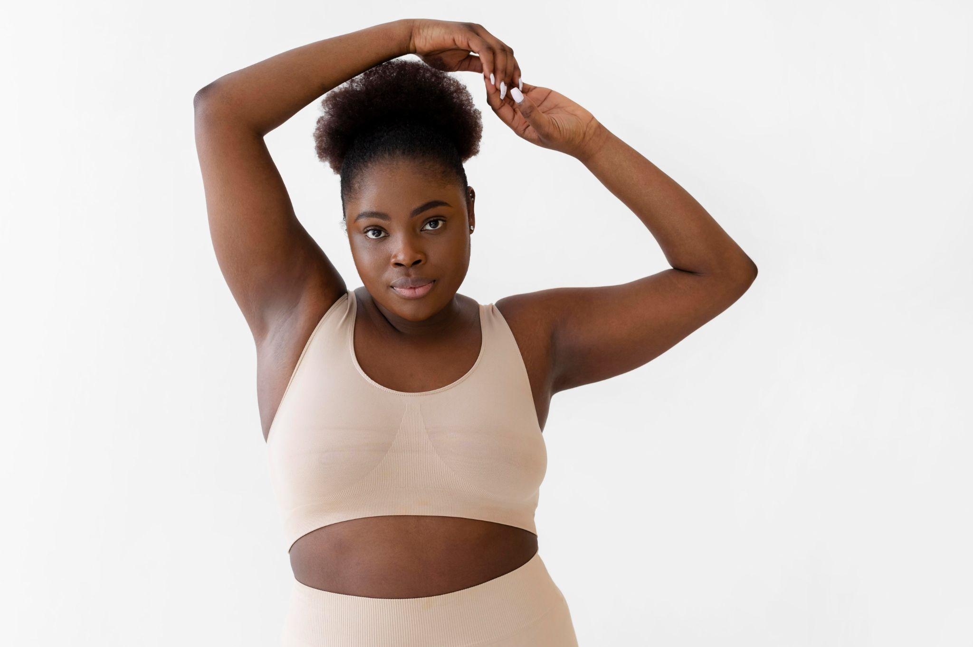
Migrant Women Empowerment
Workshop
Fun Quiz
Game

Slide 20
Coffee Break

Slide 21
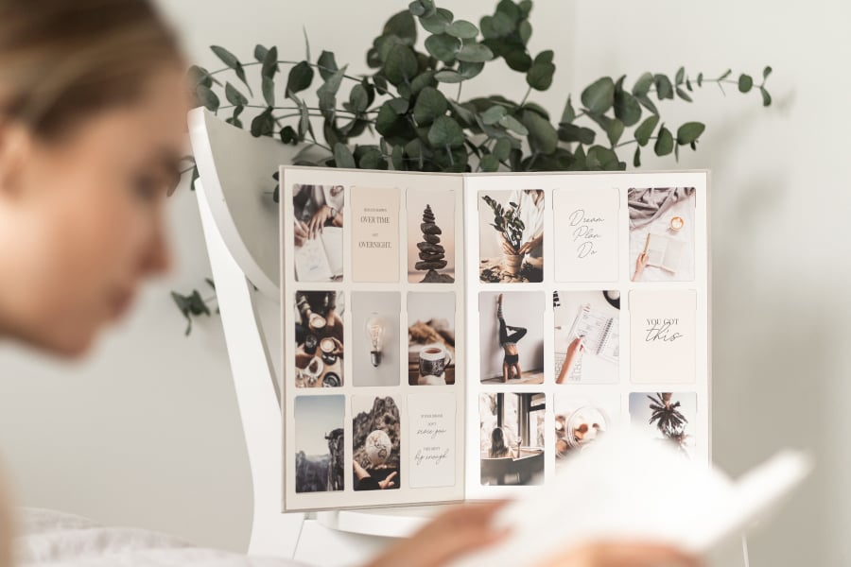
Vision Boards
Migrant Women Empowerment
Workshop
A vision board is a place that displays what you want in life. When you hang it in a space where you see it daily, your vision board brings your goals and aspirations to life.
Vision boards push you to consider what you truly desire.
Vision boards will get you all fired up emotionally.
Vision boards help you get unstuck.
Vision boards provide you with a daily visual reminder of your dreams and goals.
Vision boards are fun. ☺

Slide 22
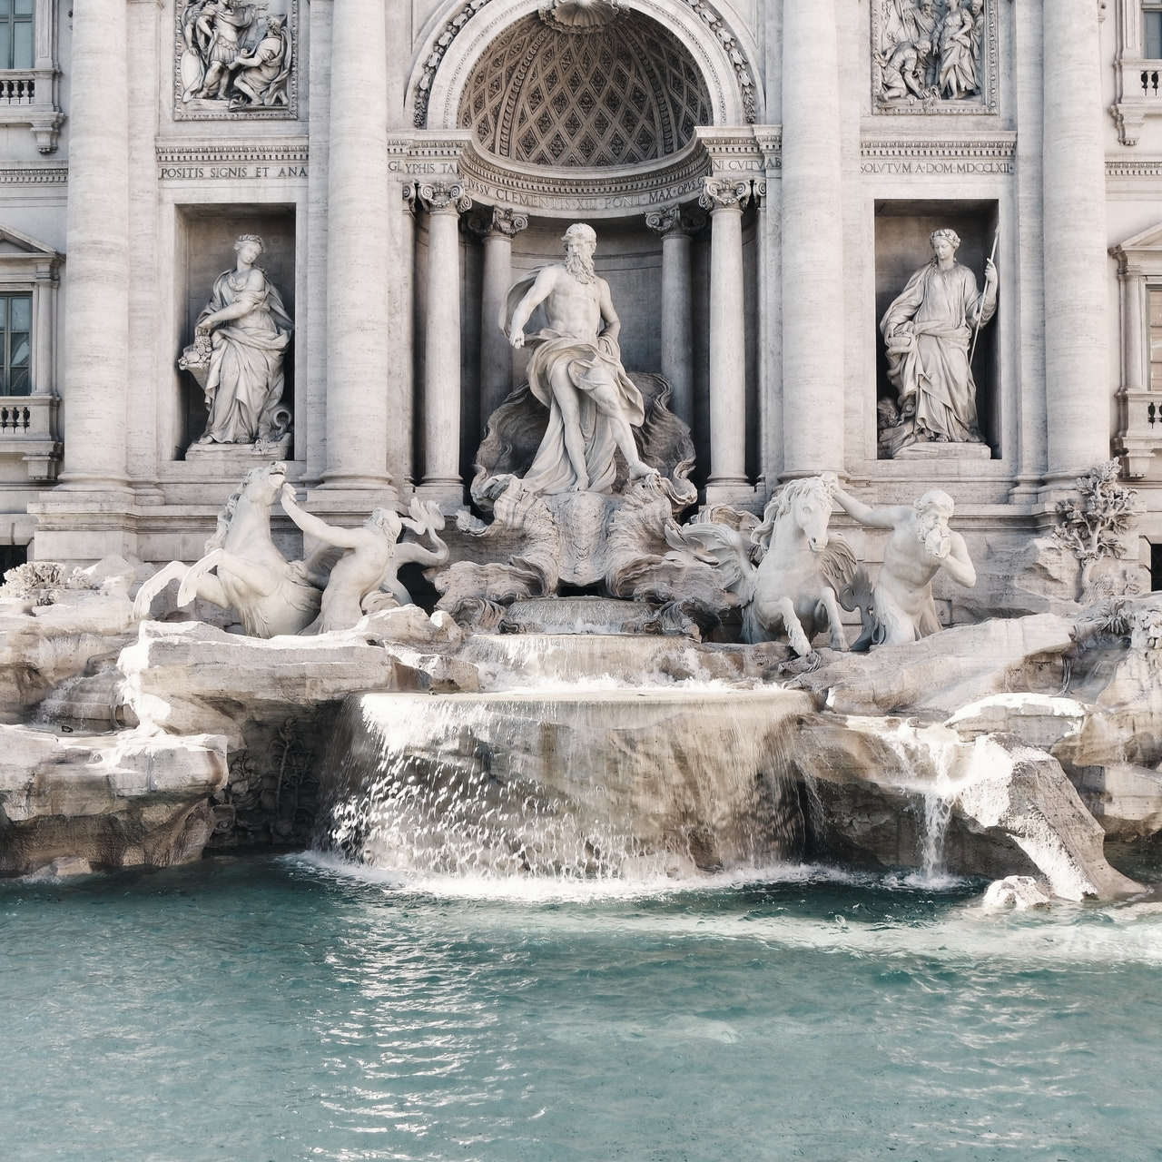
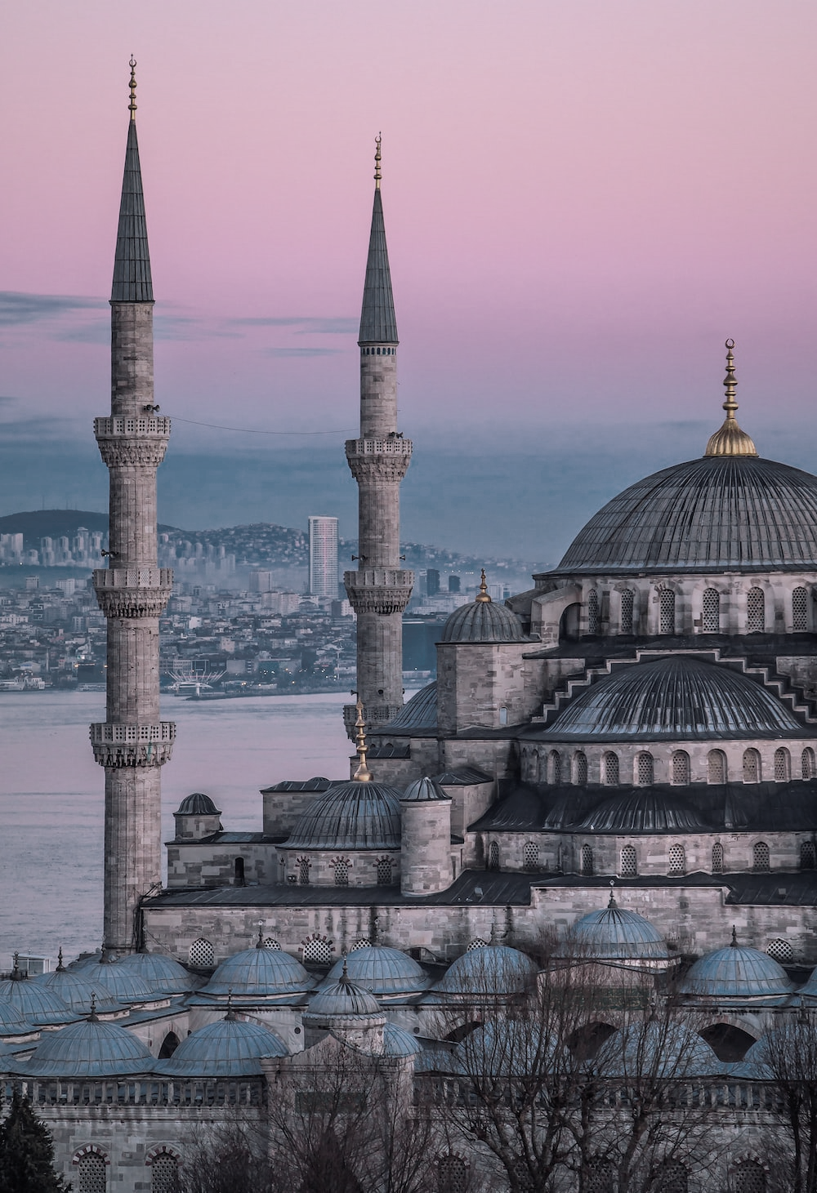
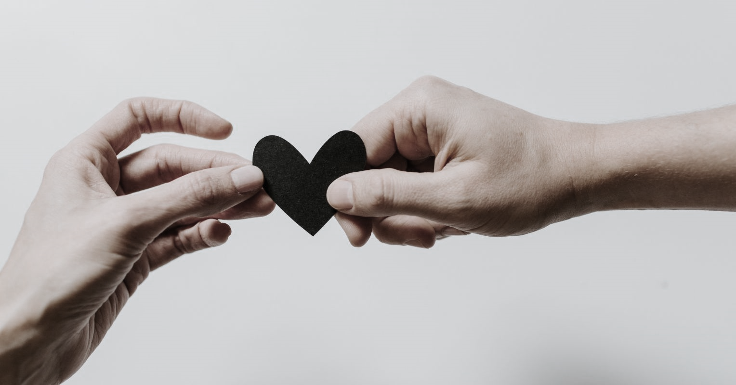
My experience

Slide 23
Every woman needs to see this…
Notes:
https://www.youtube.com/watch?v=5DtDJABXkIo

Slide 24
Thanks!
Migrant Women Empowerment
Workshop
Do you have any questions?
www.women-power.eu

